Slide 1
Animation & Games Module
Project: Breakout
Exercises:
Bricks (easy enough)
Ball & Paddle (trickier)
Breakout (for A+ kids only)

Slide 2
Exercise 1: Bricks
Your goal in this assignment is to create a breakout game. We will start by making the bricks.
There are NUM_ROWS rows of bricks, with NUM_BRICKS_PER_ROW bricks per row. You should write everything in terms of these constants, and use loops and functions to avoid redundant code.
More tips in the exercise tab!

Slide 3
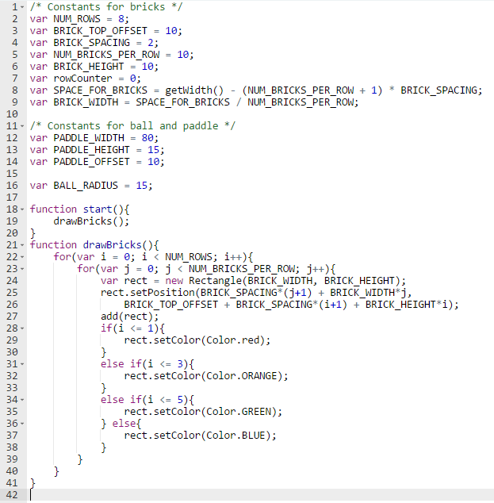
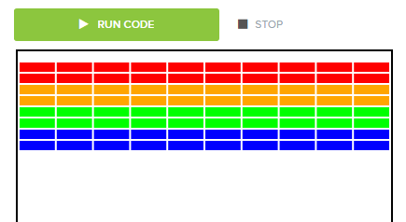
Plan Bricks Exercise:
You’re given these
global variables
Start function
i = rows; J = columns.
Look closely at lines 25 & 26
Adding colors
Notes:
On line 25 it’s saying to create each of the rows one by one, with each rectangle being placed at X: BRICK_SPACING + J+1 (which is the amount of spaces already created for the row) + BRICK_WIDTH*j (which is the total width for the rectangles already created), Y: the rectangle gets placed at BRICK_TOP_OFFSET+BRICK_SPACING + i+1(which signals that the a space above the rectangle of a certain height, plus the amount of spaces already created for the column, and adding to that the total height of the bricks created in that column)

Slide 4
Exercise 2: Ball & Paddle
Overview
Add the ball and paddle. The ball should bounce around the screen. The paddle should move with the mouse.
Add Ball and Paddle
The first step is to add the ball to the center of the screen and the paddle to the bottom of the screen.
The next step is to get the paddle to move when you move the mouse. The paddle should be centered under the mouse, and should not go offscreen.
Move Paddle, Bounce Ball
The next step is to get the ball to bounce around the screen. We may have done this exact problem before...

Slide 5
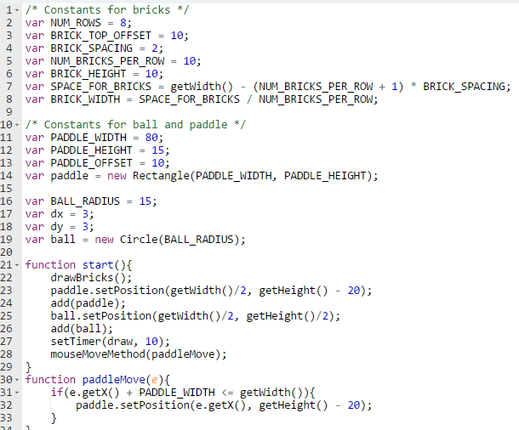
Plan Ball & Paddle Part 1:
Add these global variables
Add to Start function (the -20 on line 23 is to raise the paddle a little above the bottom of the canvas
paddleMove function – see -20 on line 32)
draw
function

Slide 6
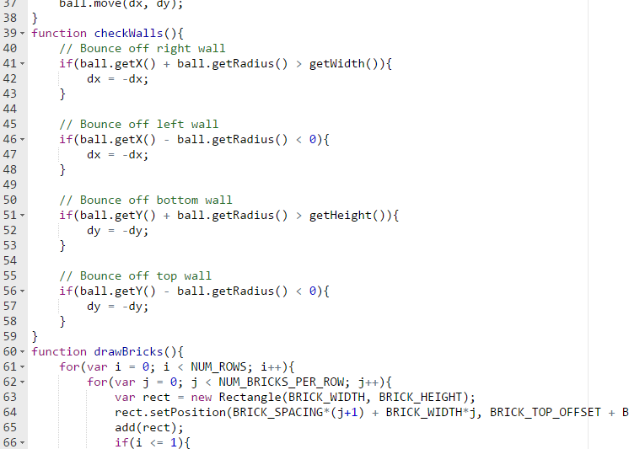
Plan Ball & Paddle Part 2:
Function checkWalls
Remember Teleporting Ball?? Copy/paste from there.
Copy/paste drawBricks from Ex. 1

Slide 7
Exercise 3: Breakout (1 of 2)
The last part of the game is to get collisions working. You should remove bricks when the balls collide with them. This is VERY similar to bouncing the ball.
You just need to use the getElementAt(x, y) function to see if there is an element where the ball is. If the element is not null, then you can remove it with the remove function.
You also need the ball to bounce up if it collides with the paddle
You want to check the four corners around the ball to see if there is an element there.

Slide 8
You Try: Breakout (2 of 2)
You want to check the four corners around the ball to see if there is an element there.
Last, there are just some miscellaneous things you can do:
Pause the ball when it gets reset until you click. Kinda like the Pause Ball exercise.
Stop the game after the ball falls to the bottom 3 times.
Stop the game when all the bricks are removed.
Display messages on the screen when you win or lose.
Then, you can just go crazy with extensions like these:
Display a score.
Add powerups.
Add cheat codes.
Add multiple difficulty levels.
Anything else that you can think of

Slide 9
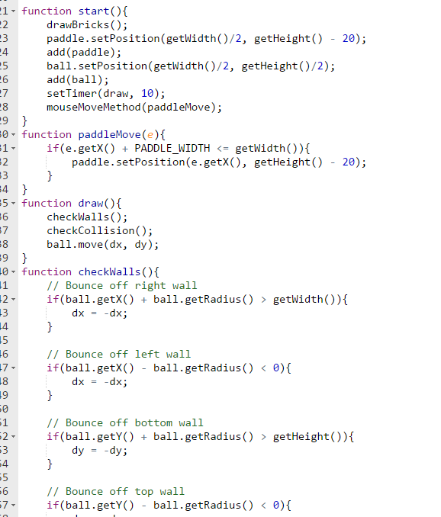
Plan Ball & Paddle Part 1:
Copy/paste Start & paddleMove from Ex 2
Add line 17 to checkWalls
Copy/paste CheckWalls from Ex .2

Slide 10
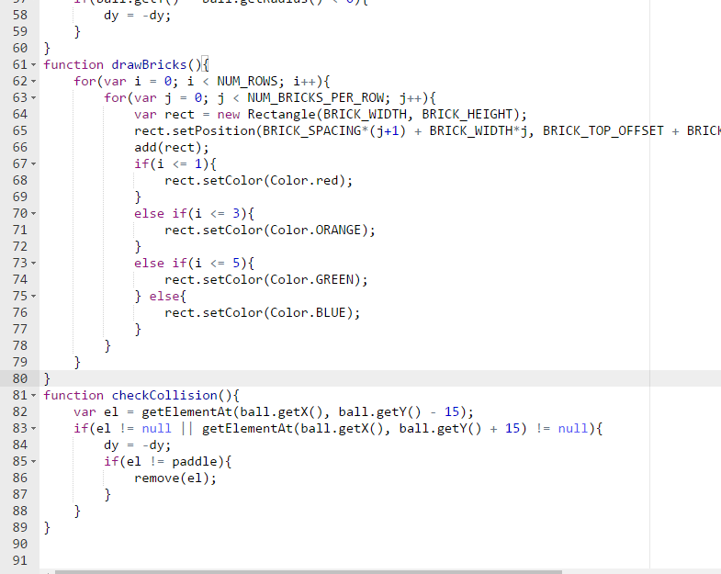
Plan Ball & Paddle Part 2:
Copy/paste drawBricks
from Ex 2
Function checkCollision

Slide 11
