Slide 1
Logging into NC Lab
desktop.nclab.com

Slide 2
Create Your Account:
Click on “Log in with Google”
Use your CUHSD email address to create your account
Once you’re logged onto the desktop, go through three panels that select language, wallpaper, and an avatar.
desktop.nclab.com

Slide 3
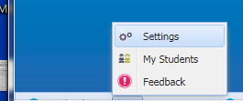
Join the Class
Go to settings (bottom left of desktop).
On the Student tab, enter my class code:
Period 5 Code: pjqkt
2
1
desktop.nclab.com

Slide 4
Create Your Account:
Click on “Log in with Google”
Use your CUHSD email address to create your account
Once you’re logged onto the desktop, go through three panels that select language, wallpaper, and an avatar.
desktop.nclab.com

Slide 5
Join the Class
Go to settings (bottom left of desktop).
On the Student tab, enter my class code:
Period 6 Code: y72zy
2
1
desktop.nclab.com

Slide 6
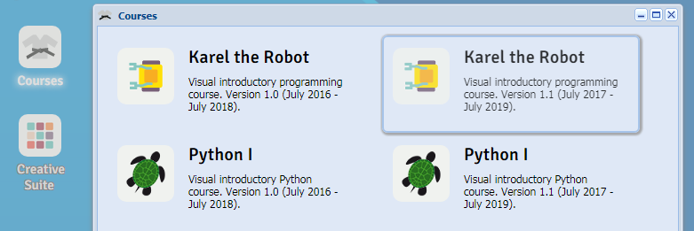
Karel the Robot
Click the Courses icon on your desktop
Make sure that you click on Version 1.1 Karel (it’s on the right hand side)
If you choose the wrong course you’ll have to redo your work.
Set up OneNote next!

